Slide 1

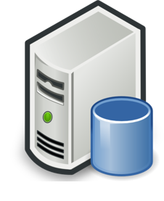


Present Branching Strategy for UI-Team
Master
Pull
Push & Merge
(Production)
Deploy to Prod-server
Release_1.29_Prod
Prod - Environment
Pull
Push
Deploy to Test-server
(Testing)
Local Repo-1
Pull
Push
Test_1.29.1
Test - Environment
Local Repo-2
Pull
(Unit Test)
Push
Deploy to Dev-server
Development_Deploy
Local Repo-3
Dev - Environment
Created by Developers with Full access
Maintained by Release Manager

Slide 2
Branching Strategy
Master
#Feature = create feature branch from DEV branch according to task.
Sprint-<##> = can be create for every sprint
Pull
Push & Merge
(Production)
Deploy to Prod-server
Production-<##>
Day (-1)
Prod - Environment
Pull
Deploy to Test-server
Push Request
Deploy to Test-server
(Testing)
Pull
Push
#Feature <##>
Local Repo-1
Pull
Sprint-<##>
Test - Environment
Push Request
Pull
Pull
Pull
(Unit Test)
Push
Push Request
#Feature <##>
Push Request
Deploy to Dev-server
Local Repo-2
Pull
Pull
Push Request
Push
Dev-<##>
Dev - Environment
Local Repo-3
#Feature <##>
Created by Developers
Created by Release Manager and limited Access to Developer
Maintained by Release Manager

Slide 3
Branching Strategy for UI-Team
Master
Production
Test
Develop
Feature-1
Feature-2
Hotfix

